Slide 1
Data Analysis: Sales Prospects from Home Mortgage Data

Slide 2
Leads Analysis by Age Group
From the graph above borrowers of 65-74, have the highest average interest rate on mortgage at 3.35%; the oldest group,>74, has the lowest average interest rate on mortgage – 3. 05%. The field also shows that as the age increases, the interest rates rise and the lowest rate is for borrowers of over 74.
The borrowers between the ages of 65 to 74 have the highest average of 74 % LTV ratio .The borrowers between 45 to 64 have it at 72%. Borrowers older than 74 years have the lowest LTV ratio of 67%.
- The Debt to Income Ratio is highest for the group 65 to 74 where those borrowing money owe 33% while it is lowest for the group 25 to 34 at 28%. Borrowers of age 45-54 also have moderate debt to income ratio more precisely 31 percent.

Slide 3
Observations and Key Insights
1. Mortgage Interest Rate – Age Group
Those within the 65-74 years borrowing bracket might be considered as higher risk hence higher interest rates will be applied. The reduced rates applied to the borrowers aged >74 may signify that they were given some sort of better or more favourable lending terms or a better deal across refinancing.
2. Average Borrower Total Debt to Income Ratio by Age Group
In the case of old applicants, a high Total Debt to Income Ratio implies high credit obligations; it might also probably mean low earnings after retirement. The borrowers aged 25 to 34 are found to manage their debt effectively, most likely because their total debt or relative income is considerably lower.
3. Average of Loan-to-Value (LTV) Ratio by Age Group
Older borrowers (65 to 74) are advancing larger loans compared to their property values, probably because of property downsizing or equity withdrawal and this is shown by the higher LTV ratios for older borrowers. Lower LTV ratios for borrowers aged >74 could possibly be more equity in the house or the tendency of these borrowers to borrow small amounts.
General Sales Prospects Analysis
Target Groups
Clients, which are 35 to 44 and 45 to 54 years old have relatively balanced incomes and reasonable amount of debt which can be considered as reasonable sales potential.
Youth clients (< 25) could be attracted with competitive rates and flexible terms to offset their higher risk perception.
Marketing Strategies
Tailor marketing strategies to address the financial challenges of borrowers aged 25 to 34, such as offering products that support career growth and income stability.
Options for refinancing must be offered together with the special programs for the elderly borrowers who fall in the age range of 65 to 74 years in an aim of addressing the issue of high interest rates as well as increased levels of debts.
These inferences may be useful for making the sales decisions, defining the core audience, and adapting the mortgage services to better fit each age category.

Slide 4
First Time Borrowers Analysis
First-time buyers have a higher average LTV ratio (86.31%) compared to non-first-time buyers (68.73%).
First-time buyers have a slightly lower average debt-to-income ratio (29.82%) compared to non-first-time buyers (30.36%).

Slide 5
Key Insights and Recommendations
First-time buyers might be more cautious with their debt levels or have fewer financial obligations.
Tailoring financial advice and products to help first-time buyers manage their debt could attract more of this demographic
First-time buyers likely need higher loan amounts relative to the value of the home due to lower initial equity.
Mortgage products that offer higher LTV ratios or lower down payment requirements would appeal to first-time buyers.

Slide 6
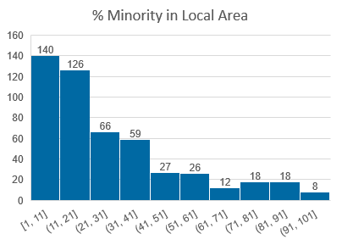
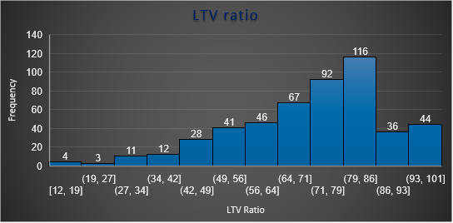
All Round Market Insight
Many Bank Clients have less than 20% Minority in local area.
There is a strong positive correlation between the appraised value of homes and the loan amounts, as indicated by the R² value of 0.669.
Majority of bank Clients have LTV Ratio higher than 64% indicating good home equity and upselling potential on majority.

Slide 7
Summary of Inferences
Target Groups and Marketing Strategies:
Younger Borrowers (< 25): Focus on flexible, low-interest mortgage products.
Older Borrowers (65 to 74): Provide refinancing options and support to manage higher debt levels.
First-Time Buyers: Offer high LTV mortgage products and tailored financial guidance.
Market Segmentation
Prioritize regions with higher median family incomes and lower minority percentages for broader marketing campaigns.
Develop specific marketing strategies for high minority percentage areas to cater to their needs
Product Offerings
High-value loan products should target higher appraised home value markets.
Custom mortgage solutions for non-first-time buyers to leverage their higher borrowing capacity.
Sales strategies should consider targeting areas with lower minority percentages more heavily, as these represent a larger market segment.
Minority-focused marketing strategies might be beneficial in the top two brackets to address specific needs or preferences
Higher home values generally lead to higher loan amounts, which is expected in a proportional lending environment.
Marketing high-value loan products should target higher-value home markets.

